Slide 1

Information Assurance
Introduction To Information Assurance

Slide 2
Information Quality Vs. Value
The CIA Triad described the aspects of data that, if compromised, reduce its quality.
Data quality: The information satisfies the requirements of its intended use.
In short – Information Assurance seeks to make sure data retains its information quality.

Slide 3
Information Quality Vs. Value
The quality of information is only part of what makes it valuable… In some cases, quality is irrelevant in its value. Value may be extrinsic or intrinsic.
In some cases, information quality is completely irrelevant to its value. (Something can have perfect quality, but not be valuable.)
Information Security seeks to protect and preserve information because it has value.

Slide 4
Extrinsic value
Extrinsic value – The data in question has a objective value. It can be monetized (It can be sold or traded.)
Medical records
CHD
Information that is useful for accessing other data.
Information that is intrinsically valuable to the victim that can be ransomed back.
Something valuable is worth protecting, because other people might seek to steal it.

Slide 5
Intrinsic value
Intrinsic value – The data in question has subjective value. It is only valuable for non-monetary reasons.
Revenge
Challenge
Recognition
Sometimes the goal of an attack is to intentionally reduce the extrinsic value of data, but the motive for the attack is intrinsically valuable.
A victim may find data intrinsically valuable because of embarrassment, emotional attachment, etc.

Slide 6
Examples of quality and value
 |  | Attacker |  | Victim
Data | Quality | Extrinsic Value | Intrinsic Value | Extrinsic Value | Intrinsic Value
Current phone book | Yes | Low | Depends | High | High
Phone book from 1977 | No | Low | Depends | Low | Low
Unverified email dumps | No | Low | Depends | Low | High
A protected DB of full CHD | Yes | High | Depends | High | Low
A protected DB of medical record | Yes | High | Depends | Low | High
A DB of current customer creds | Yes | High | Depends | High | High
A list of customers from 2017 | Yes | Low | Depends | Low | Low

Slide 7
Brass tacks
So…
Data is valuable.
Organizations generate and consume a lot of data.
If something is valuable, someone will try to take it.
The only way to prevent this is to:
Eliminate the possibility.
Deter the attack.
And the only way to do that is by understanding risks.

Slide 8
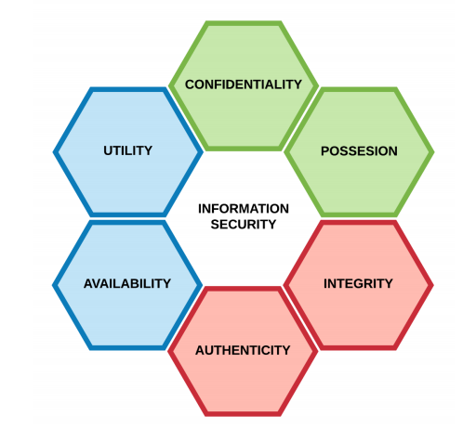
Elements of data value (Parkerian Hexad)
Confidentiality
Exclusivity - Data that is restricted to select or privileged individuals is more valuable than data that is available to the public. Data that is restricted to executives or a research team is more valuable than data that is restricted to the entire company.

Slide 9
Elements of data value (Parkerian Hexad)
Possession
Data is not useful unless you have it in your possession. Likewise, when someone possesses data and it is suddenly gone, it becomes more valuable to them.

Slide 10
Elements of data value (Parkerian Hexad)
Integrity
Integrity refers to being correct or consistent with the intended state of information. Any unauthorized modification of data, whether deliberate or accidental, is a breach of data integrity.

Slide 11
Elements of data value (Parkerian Hexad)
Authenticity
Authenticity refers to the veracity of the claim of origin or authorship of the information. In the sense of accuracy, authenticity refers to the verifiability of information from the origin.

Slide 12
Elements of data value (Parkerian Hexad)
Availability
Availability means having timely access to information. For example, a disk crash or denial-of-service attacks both cause a breach of availability. Any delay that exceeds the expected service levels for a system can be described as a breach of availability.

Slide 13
Elements of data value (Parkerian Hexad)
Utility
What can the data be used for? Could it be sold wholesale on the darkweb? Could it be used to obtain other, more sensitive data? Can the data be read?
Data from an R&D team that could be sold to a competitor might be less valuable than medical records, because medical records can be used for many different things.

Slide 14
What is sensitive data?
You will often hear about data classification – this is a way we try to categorize data so that we know where to best put or efforts and controls.
This is where we get the concept of sensitive data.

Slide 15
What is sensitive data?
Data can be sensitive because it is valuable.
Data can be sensitive because its quality is mission critical.
Data can be sensitive because it must be protected to certain standards due to federal regulations.
Data is often audited by a qualified person to determine whether or not the storage, use, and transmission of sensitive data is in compliance with the applicable policies and regulations.

Slide 16
Personal Identifiable Information
The most common form of sensitive data is Personal Identifiable Information (PII). In short, information that could be used to identify an individual if applied to a set of individuals. I know that seems tautological, so let me put it this way…
I am an individual. (1 of 7.3 billion people.)
I live in the United States (1 of 326 million people.)
My name is Chad Johnson (1 of 269,848 people.)
My name is Chad Johnson and I live in the US (1 of 1,858 people.)
My Social Security Number is NUNYA BEESWAX (1 of 1 people.)

Slide 17
Types of Data - PII
HOWEVER – not all PII is sensitive. There are some types of information that are self-evident – that are so specific to one person that they can be used by themselves to identify an individual. Some PII is non-sensitive, but could be used if enough is present or in conjunction with other information to specifically identify a person.
Data that is automatically sensitive PII is known as axiomatic PII.
Data that is not automatically sensitive PII is known as demonstrable PII.

Slide 18
Types of Data - PII
Axiomatic PII:
Face (sometimes)
Home address
National identification number
Passport number
Vehicle registration plate number
Driver's license number
Face, fingerprints, or handwriting
Credit card numbers
Digital identity
Genetic information
Telephone number
PHI (Personal Health Information)
Demonstrable PII:
First or last name, if common
Country, state, postcode or city of residence
Email address
Age, especially if non-specific
Gender or race
Name of the school they attend or workplace
Grades, salary, or job position
Criminal record
Web cookie
Birthplace
Date of birth
Salary information

